Slide 1
The Use of Natural Language Processing in Detecting Cyberbullying Trends in Public Social Media Posts
Samantha Mallari Faith Ballesteros Eva Samillano
(Project Manager) (Documentations Manager)

Slide 2
Background of the Problem

Slide 3
Bullying: How it changed over a period of time
-First discovered on primates
-During the era of the Homo-sapiens
- Purpose of bullying was redefined (from social dominance to a mere destructive act)
-Bullying in the 21st century
- Cyberbullying
Introduction to Cyberbullying
-Definition of Cyberbullying
Cyberbullying in the Philippines
-Typical scenarios
-How we dealt with it

Slide 4
Statement of the Problem

Slide 5
How can Natural Language Processing (NLP) techniques be applied in the process of automating the method of detecting cyberbullying occurrences in public social media posts?

Slide 6
Objectives

Slide 7
Main Objective
This research aims to formulate a cyberbullying detection model which will yield an accuracy of least 70-80% in terms of detecting cyberbullying occurrences present in public social media posts. Results that will be derived from the model will aid social media moderators in their task of preventing the growth of cyberbullying events.
Specific Objectives
-To acquire ample data for the corpus
-To apply text pre-processing to the statements included in the dataset
-To extract and evaluate significant features from the corpus
-To develop classes based from the predefined categories of cyberbullying (refer to IV. Design and Methodology)
-To devise appropriate experiments which will test the cyberbullying detection model's accuracy

Slide 8
Significance

Slide 9
Automated detection of cyberbullying posts in social media sites can lessen the difficulty of filtering inappropriate posts by the moderators
The younger population tend to visit social media sites more frequently than the rest, therefore stricter moderations must be implemented
Filipinos are reluctant to admit to being victims of cyberbullying. The current solution that social media sites are implementing will not be able to help them unless they do it (the reporting) voluntarily. Automated cyberbullying detection can greatly contribute in these scenarios (as they detect and flag such statements automatically.

Slide 10
Scope and Limitations

Slide 11
The research will discuss selected methods (which will be compared) under Natural Language Processing and Machine Learning algorithms (due to their inter-dependency towards each other)
This paper will introduce concepts which relates to the formation and the subsequent annotation and pre-processing of the textual corpus (dataset), the process of extracting features from the dataset, and the creation of classes (which will revolve around the predefined cyberbullying categories (refer to IV. Design and Methodology).
Additionally, experiments will be conducted in order to validate the efficacy of the proposed cyberbullying detection model.

Slide 12
The provided solution will be limited to the detection of cyberbullying trends in two human languages (Tagalog – as how it is used in Manila - and English) only
Posts that will be detected are only those that were made public by the user

Slide 13
Review of Related Literature

Slide 14
Natural Language Processing (NLP)
Deep Analytics
Machine Translation
Named Entity Extraction
Co-reference Resolution
Automatic Summarization
Sentiment Analysis
Text Classification
Conversational Agents

Slide 15
Textual Corpus
- a collection of large sets of text specifically chosen by the researcher to deduct his/her own linguistic analysis in the text of interest.
Corpus Annotation
Most Common Type of Annotation - putting labels or tags which indicates the class to which a particular word in the body of text belongs to.

Slide 16
Tools
LeTs Preprocess Toolkit
Natural Language Toolkit (NLTK)
Methods
Chunking
Lemmatization
Stemming
Part-of-Speech Tagging
Tokenization
Normalization

Slide 17
In 2015, Van Hee et al, conducted a research on Automatic Detection and Prevention of Cyberbullying. The team developed an annotation scheme for the analysis of textual cyberbullying.
In 2012, Dinakar, Jones, Havasi, Lieberman, and Picard conducted a research on Common Sense Reasoning for Detection, Prevention and Mitigation of Cyberbullying. Removing of stop-words and tokenizing the text to separate words from punctuation marks were performed.
Cheng and Ng conducted a research at De La Salle University. The research aimed towards detecting cyberbullying roles through textual context in Facebook and Twitter.

Slide 18
Theoretical Framework

Slide 19
Ervin Goffman introduced the mechanisms of audience segregation. He describes how people play different roles in different situations. It is a mechanism wherein an individual perform roles, in order to create a favorable image of themselves and leave a good impression to others that is linked to the role they perform. The role that the individual performs is based on who their audience is.

Slide 20
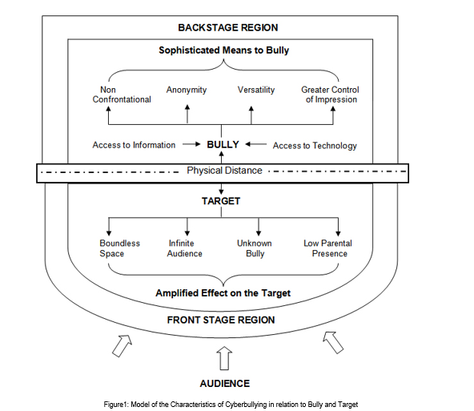

Slide 21
Design and Methodology

Slide 22



Software Application

Slide 23
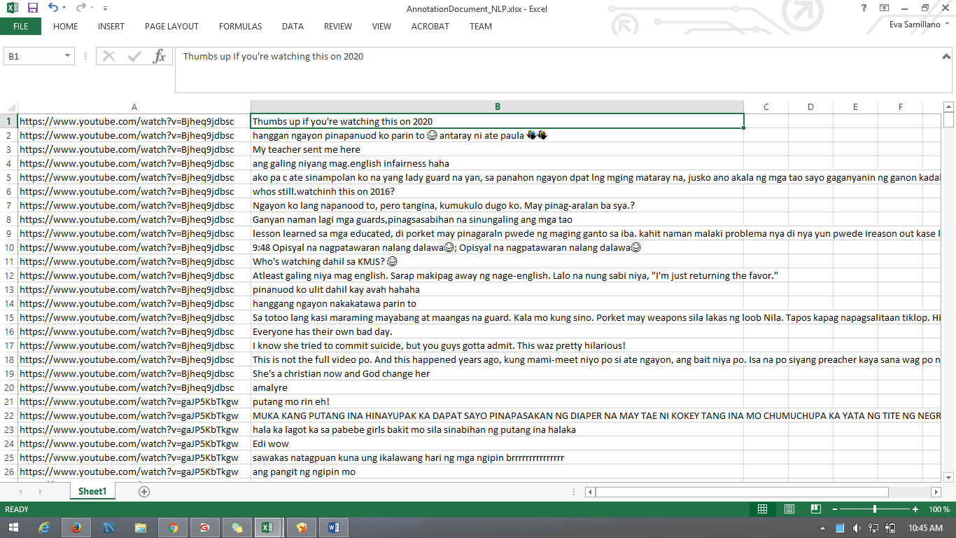
Imported Data

Slide 24
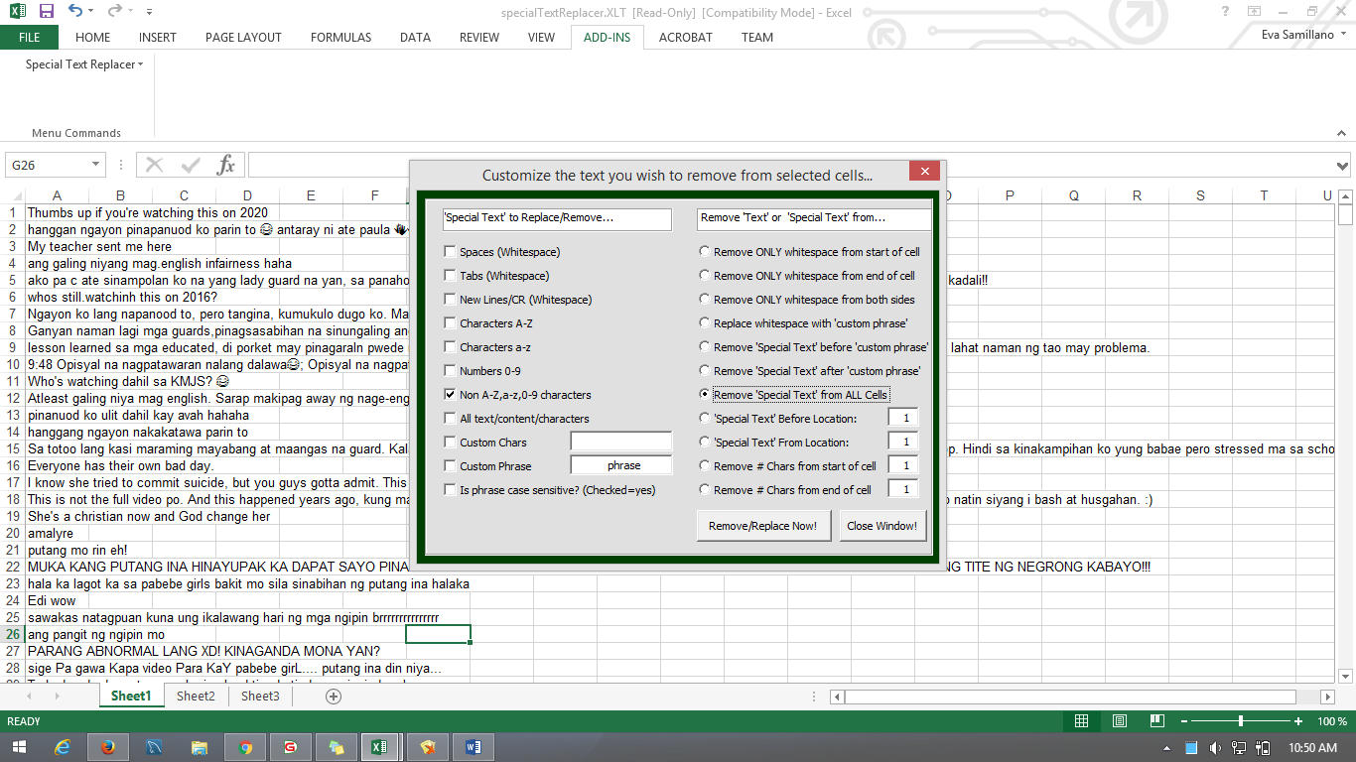
Cleaning The Data Using Excel

Slide 25
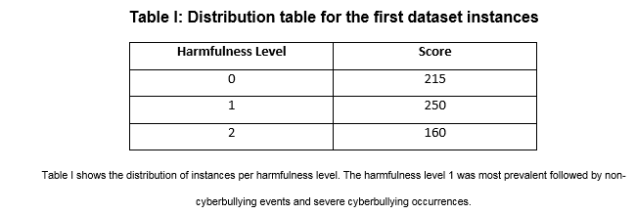

Slide 26
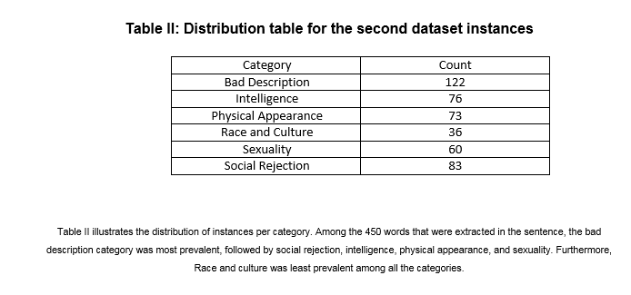

Slide 27
Sexuality – instances that contains both vulgar and filthy words.
Physical Appearance – instances that contains cyberbullying statements with regards to the physical characteristics of a person.
Intelligence – instances that attacks the mental capacity of a person.
Race and Culture – instances that contains both racial and cultural discrimination.
Social Rejection – instances that contains cyberbullying statements which isolates an individual from the society or it degrades a person.
Bad Description – instances that contains cyberbullying statements that pertains to the attitudes and behaviour of an individual. However, this categorization can be misused with the Physical Appearance.

Slide 28
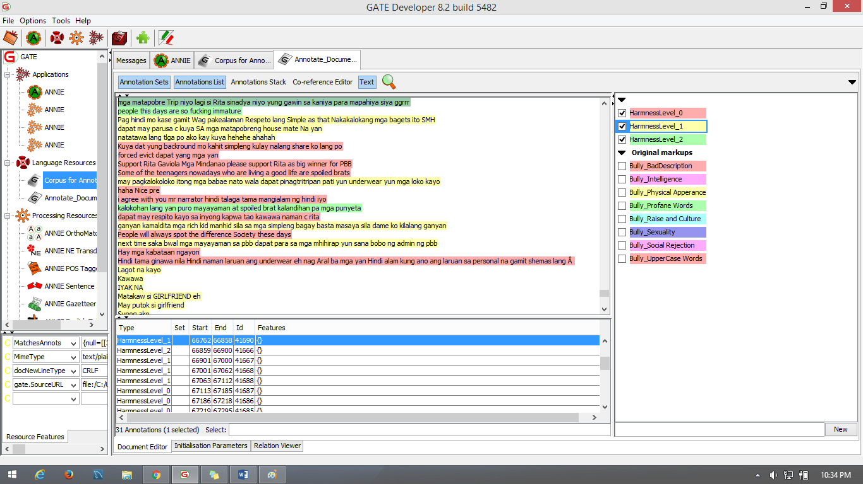
Using GATE – Annotating the Harmness of Sentence

Slide 29
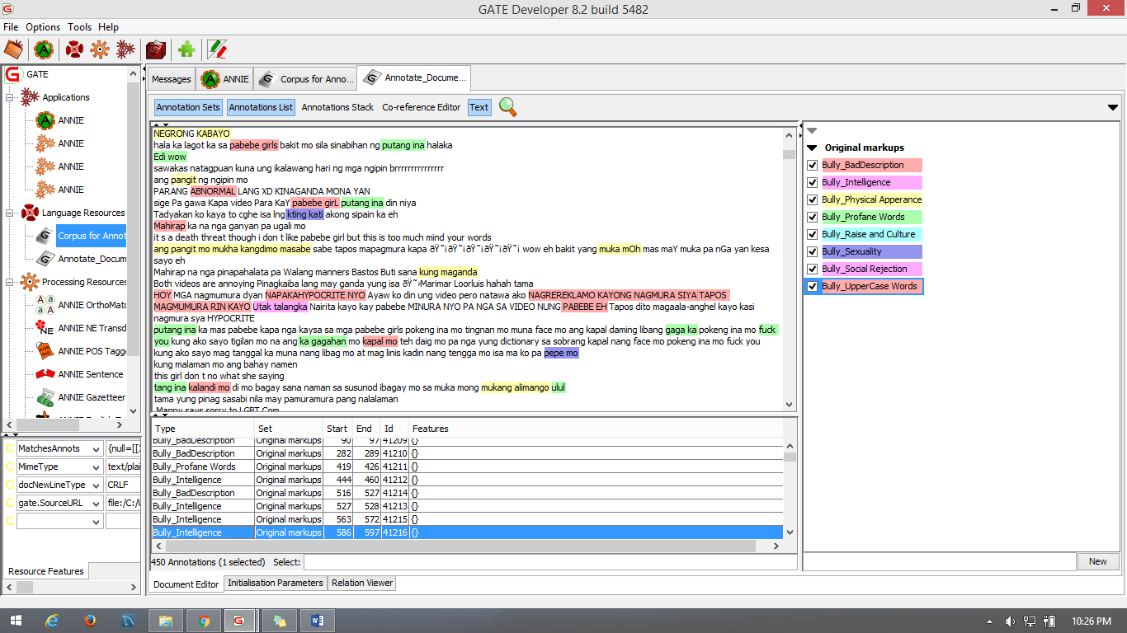
Using GATE - Annotating Bully Category

Slide 30
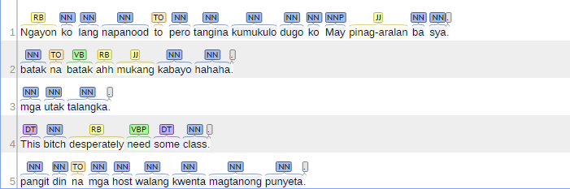
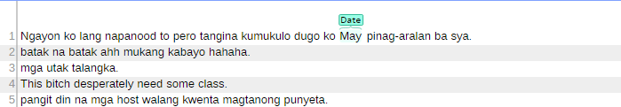
Part of Speech
Name Entity Recognition

Slide 31
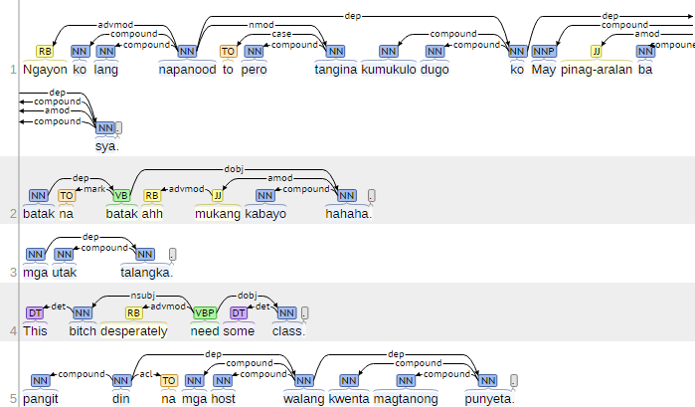
Basic Dependency

Slide 32
Results and Discussions

Slide 33
Out of 625 statements that were extracted from the social media sites, the harmfulness level 1 was most prevalent with a frequency of 33%. It was followed by non-cyberbullying events, with a frequency of 41%. The occurrences of severe cyberbullying events was least prevalent among the three classification, it has a frequency of 26%.
At the second level of annotation, the bad description was the most prevalent with a frequency of 27%, it was followed by Social Rejection (18%), Intelligence (16%), Sexuality (13%), Physical Appearance (10%) and the category Race and Culture was the least prevalent among the six categories, it has a frequency of 8%.

Slide 34
Project Diagram

Slide 35
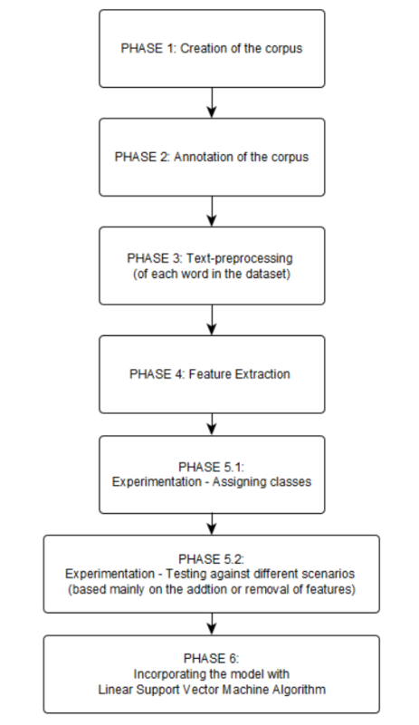

Slide 36
Screenshots

Slide 37
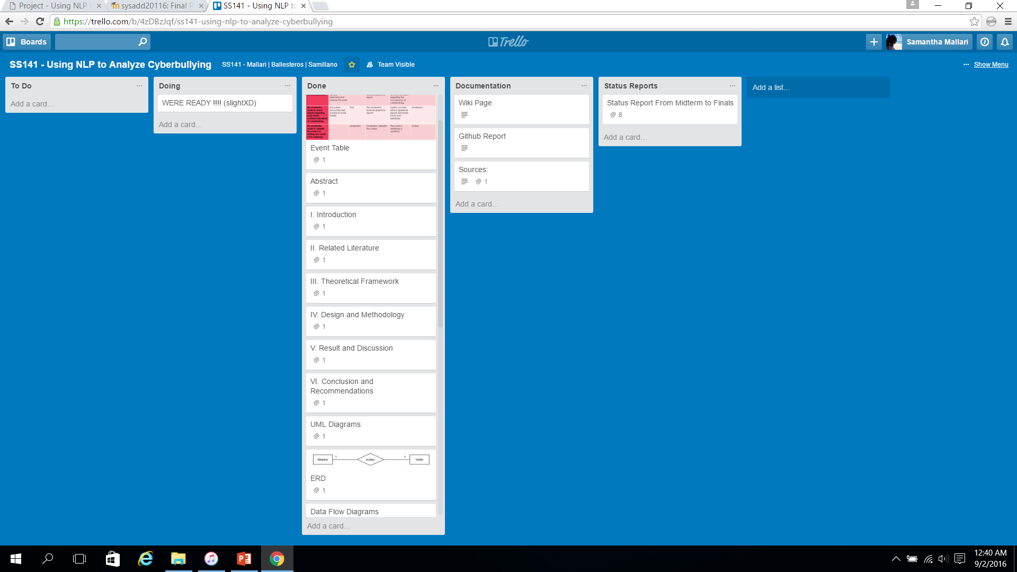

Slide 38
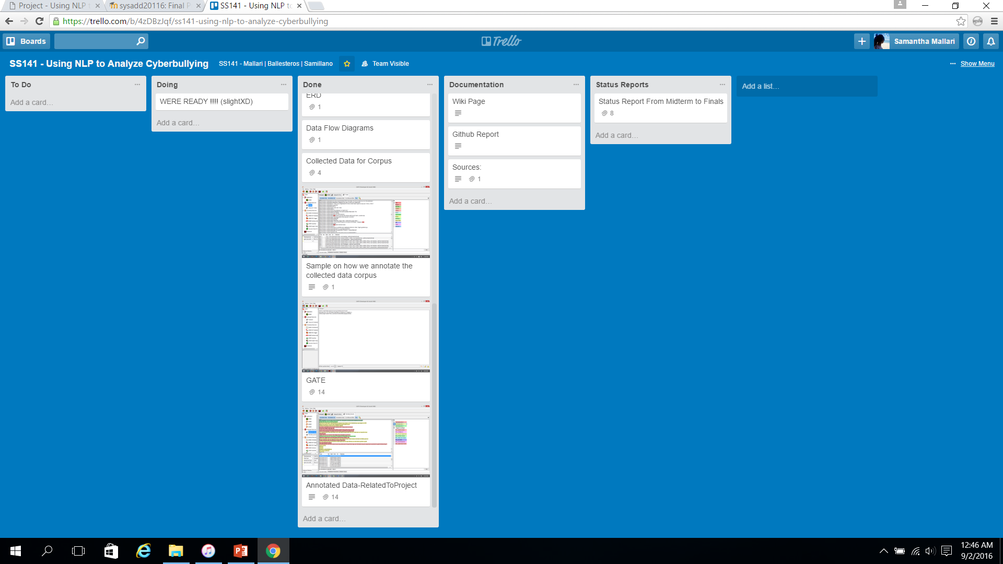

Slide 39
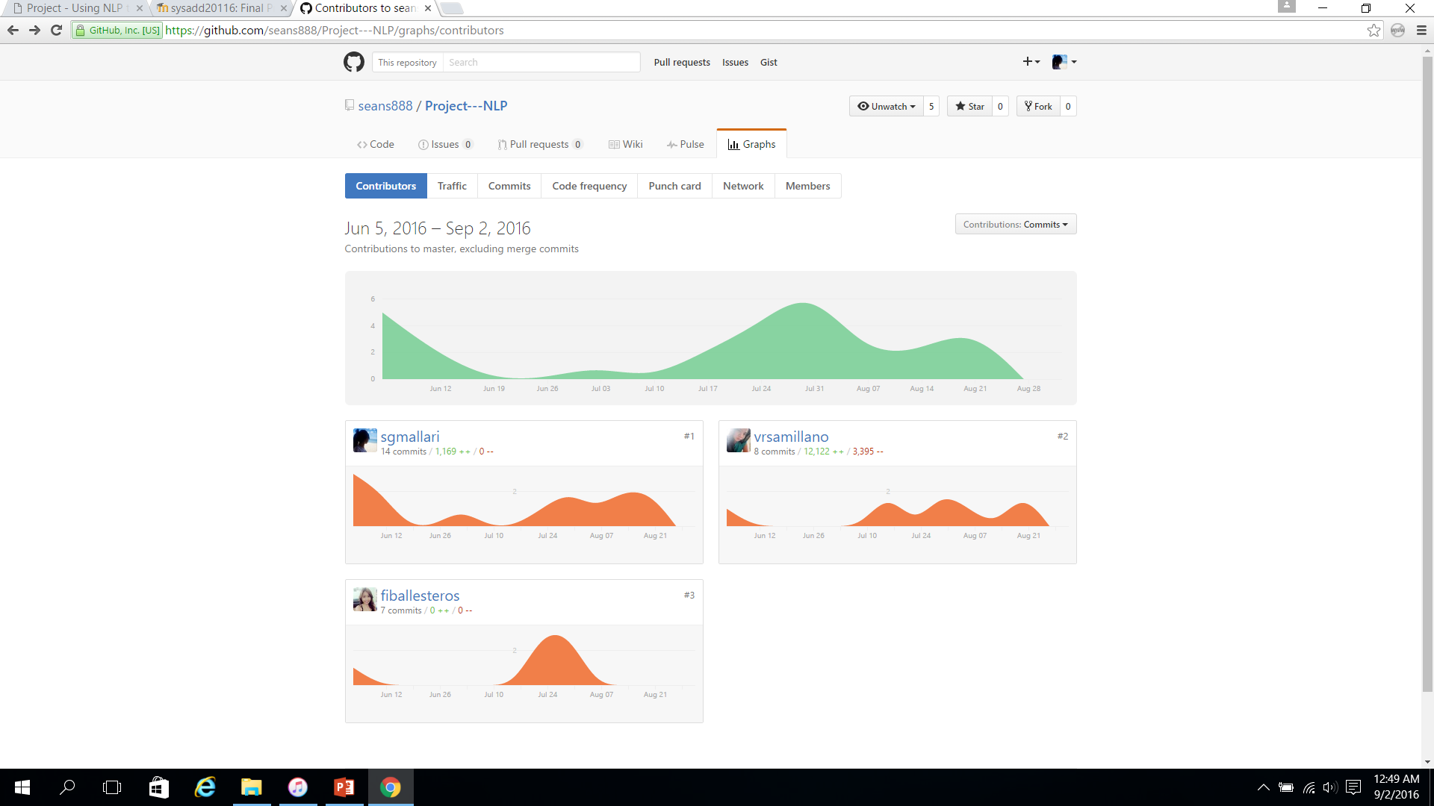

Slide 40
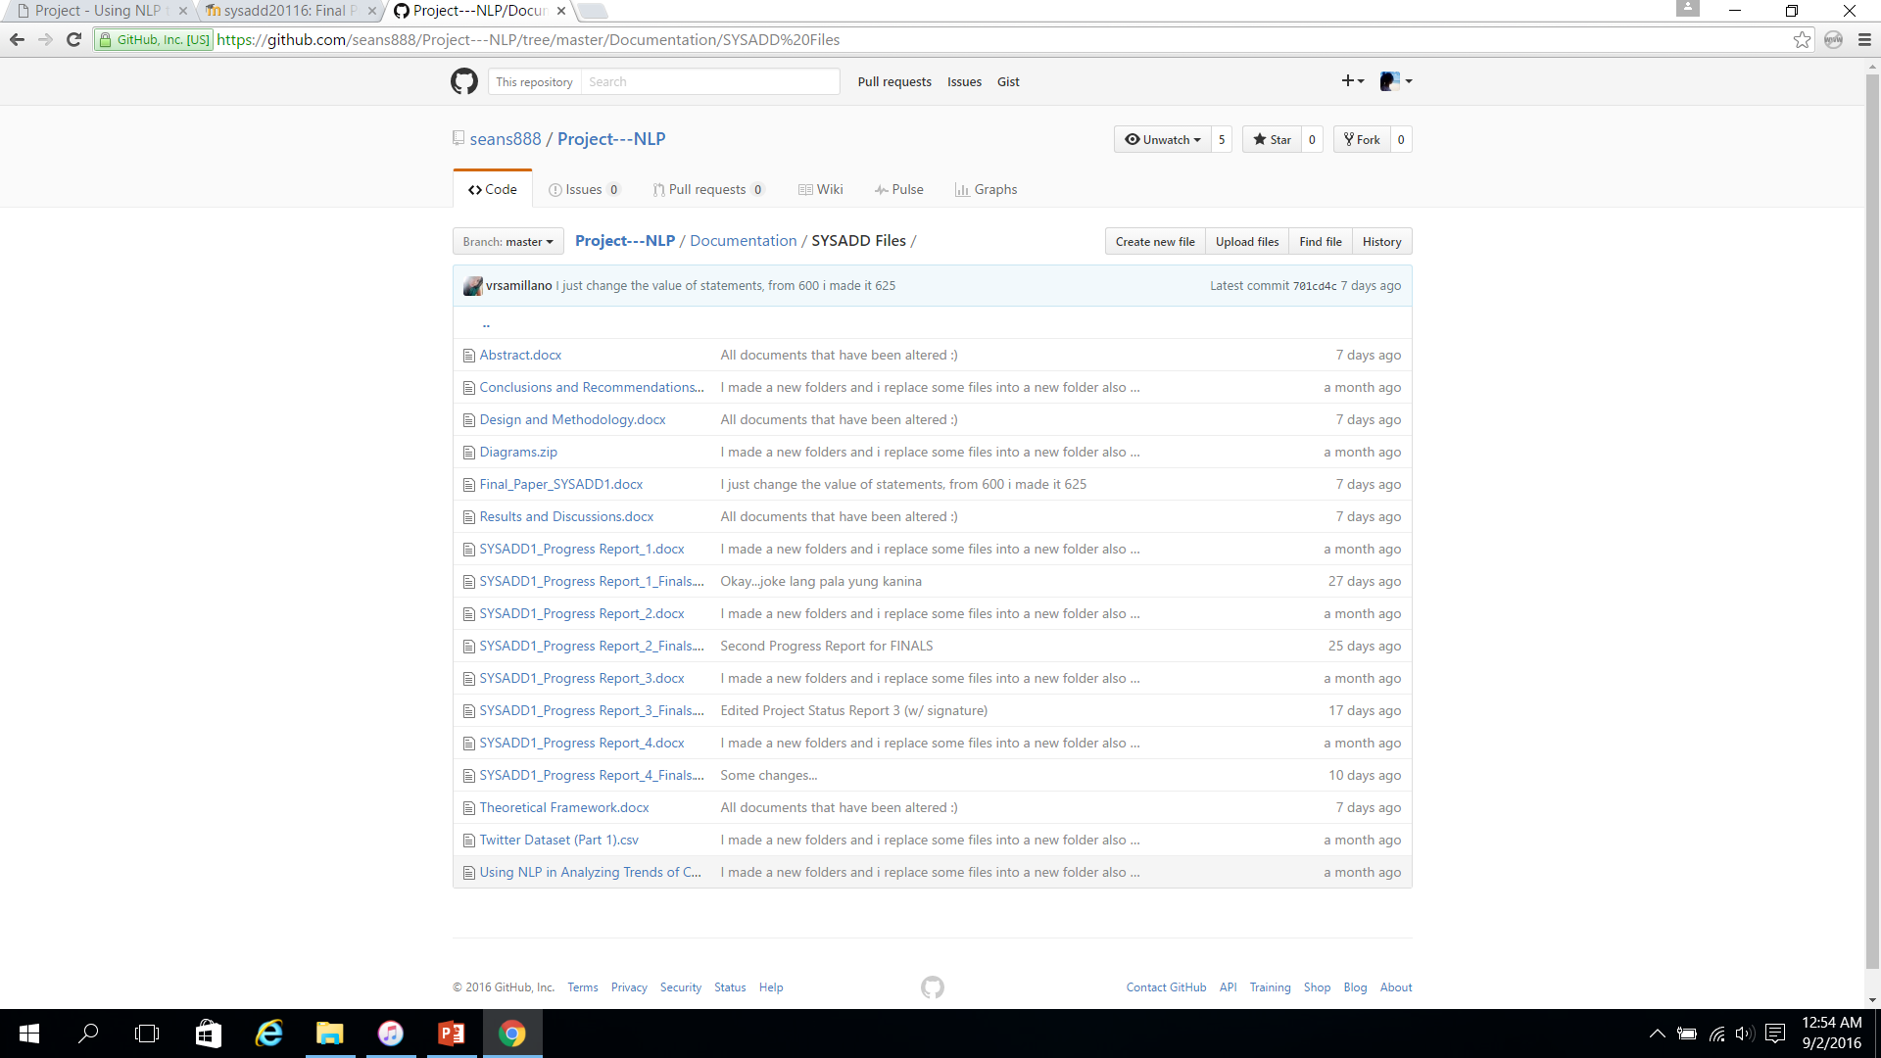

Slide 41
